Slide 1

Predictive Analysis Approach for Churn using various Machine Learning Algorithms
By
VARUN GOEL
TEJAL SHINGOTE
MAMIDI RAJESH

Slide 2
01
PROBLEM STATEMENT
02
DATA
MINING
06
PREDICTIVE MODELING
DATA SCIENCE
LIFECYCLE
03
DATA
CLEANING
05
FEATURE
ENGINEERING
04
DATA EXPLORATION

Slide 3
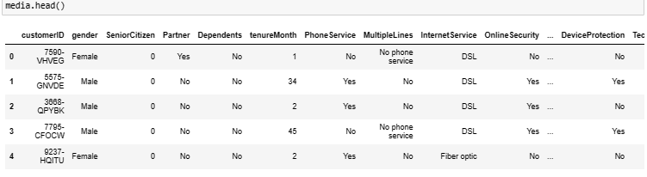
Problem Statement & Data mining As persons can easily port their numbers, so it becomes difficult for the company to understand whether the person will continue give the business to the company or not.
Attribute Information
Id: - unique identifier
Gender: - “Male” or “Female”
SeniorCitizen - yes or no
Partner - whether the person is single or having a partner
Dependents - yes or no
tenureMonth - Monthly or Quaterly
PhoneService - yes or no
MultipleLine - There are any multiple lines
InternetService - what kind of Internet service is using
OnlineSecurity - service is available
DeviceProtection - service is available
TechSupport - service is available
StreamingTV - service is available
StreamingMovie - service is available
Contract - Type of contract
PaperlessBilling - Yes or No
PaymentMethod - Modes of Payment
MonthlyCharges - Amount paid monthly
TotalCharges - Total amount paid
Churn - Yes or No

Slide 4
EDA
Exploratory Data
Analytics

Slide 5
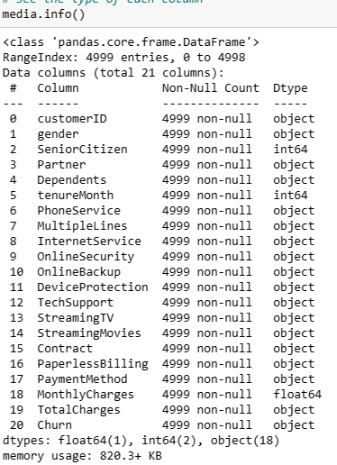
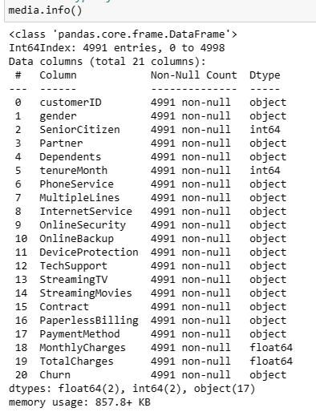
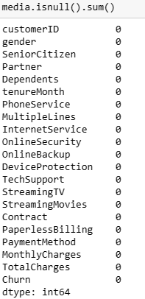
DATA CLEANING

Slide 6
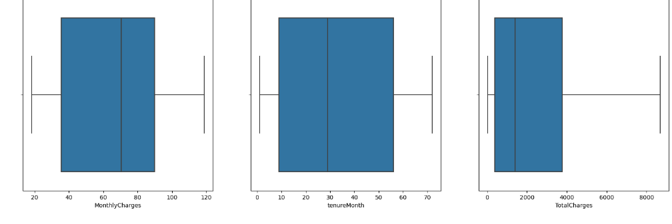
CONTINUOUS VARIABLES

Slide 7









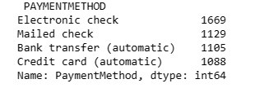





CATEGORICAL VARIABLES

Slide 8
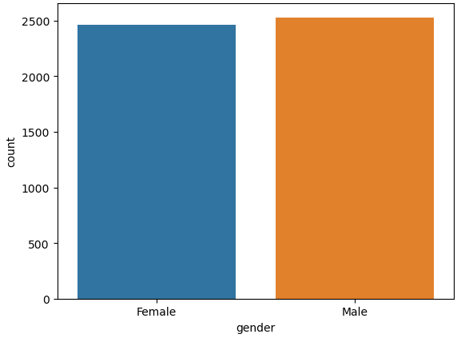
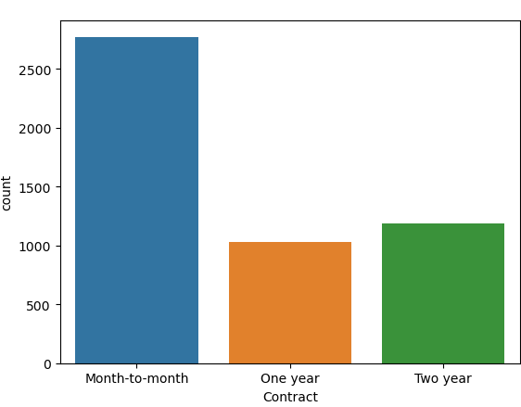
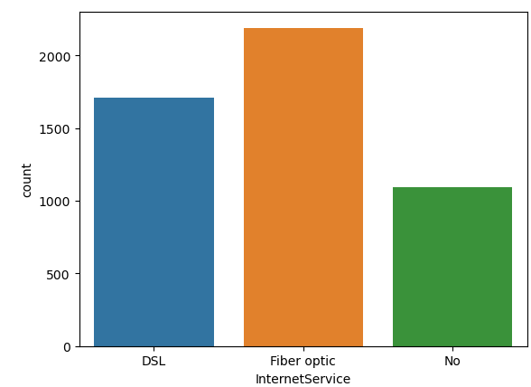
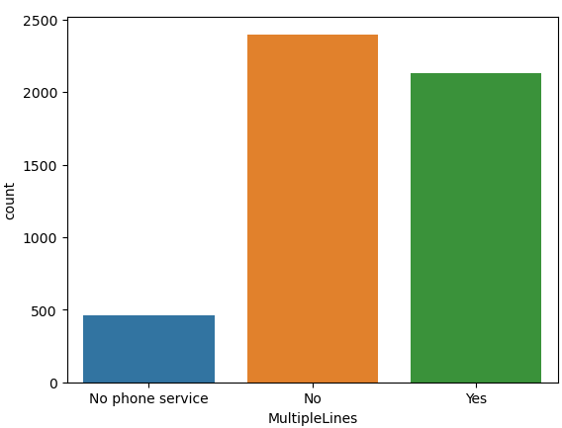
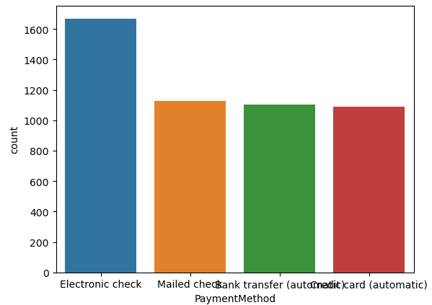
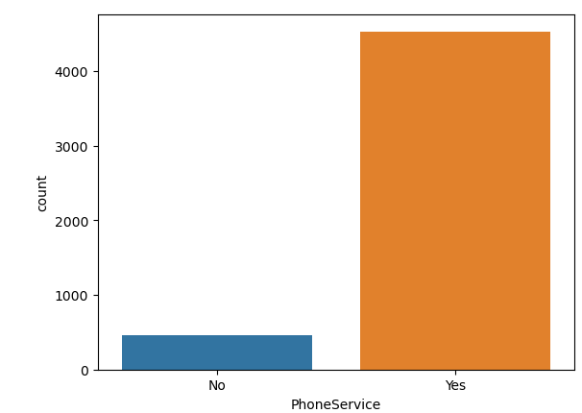
HISTOGRAM

Slide 9
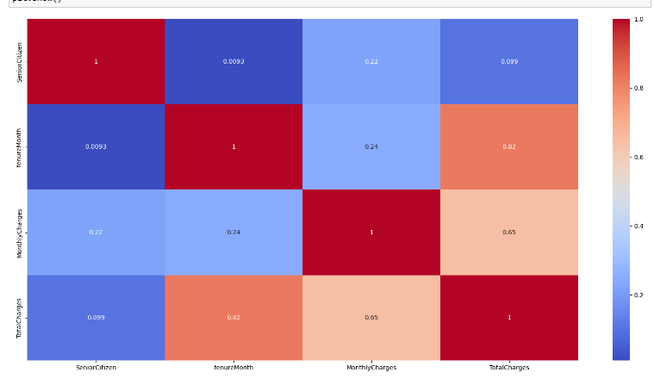
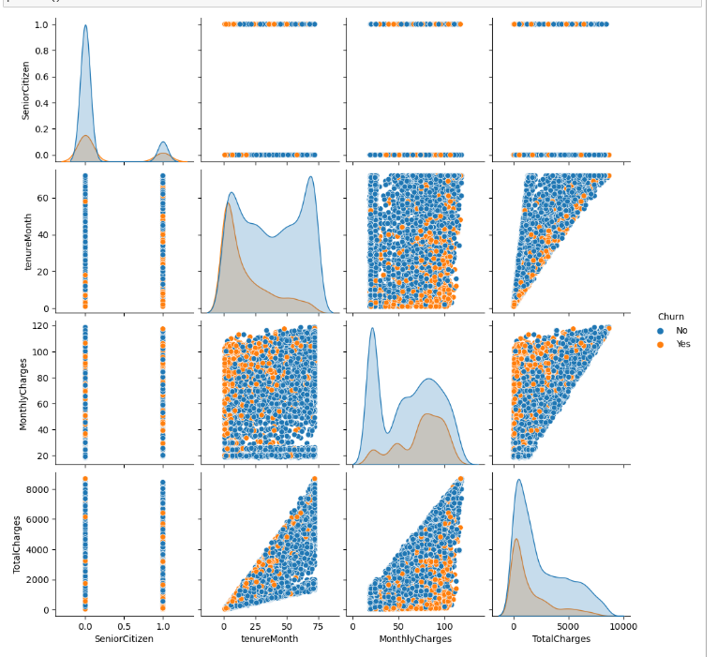
HEATMAP
PAIR PLOT

Slide 10
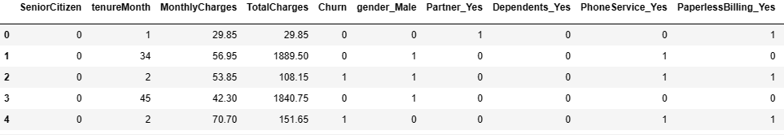
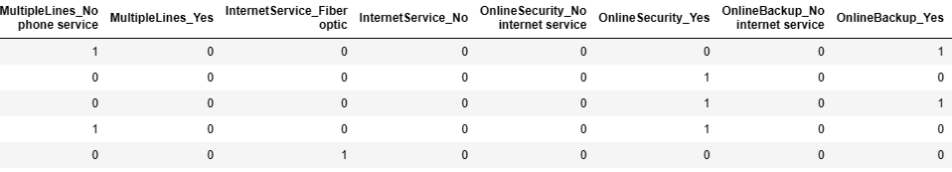
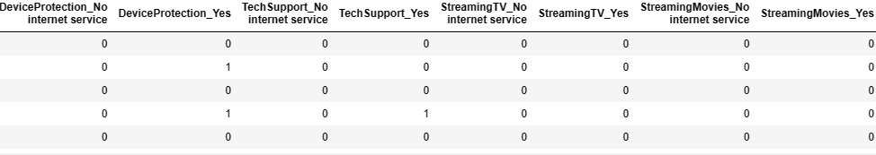
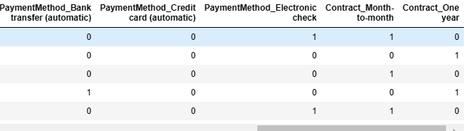
FEATURE ENGINEERING
DUMMY VARIABLES

Slide 11
MACHINE LEARNING
MODELS

Slide 12
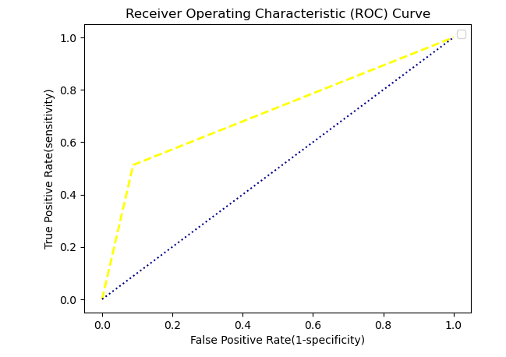
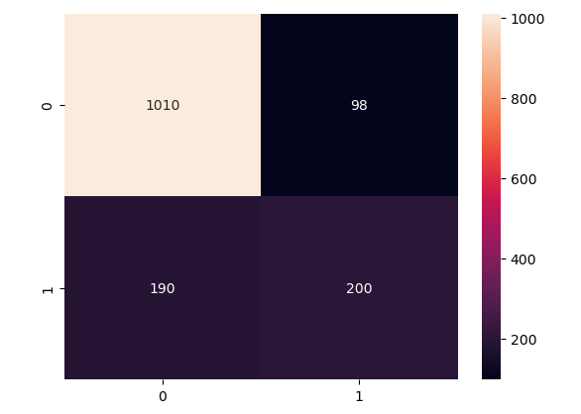
Logistic Regression
Library used : sklearn.linear model (LogisticRegression)
Split used for training and texting the data is [70 : 30]
Feature Scaling was performed after splitting the dataset to avoid information leakage on testing dataset by using standardization method.
Accuracy : 80.77%
Recall : 84.16%
Precision : 91.15%
F1 score : 87.52%

Slide 13
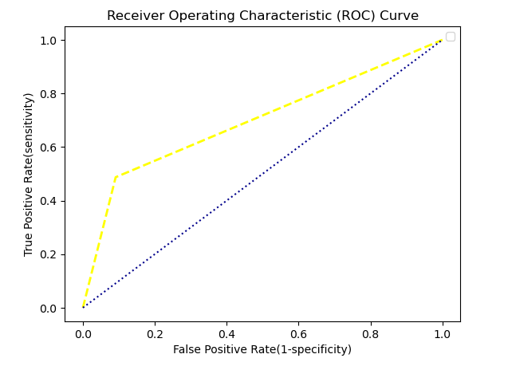
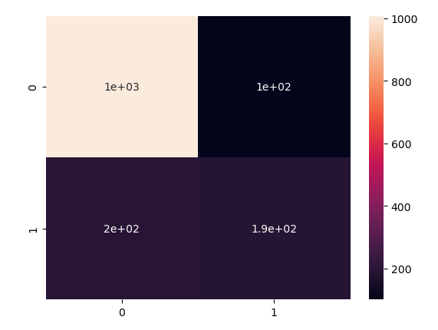
Support Vector Machine
Library used : sklearn.svm (SVC)
Split used for training and texting the data is [70 : 30]
Feature Scaling was performed after splitting the dataset to avoid information leakage on testing dataset by using standardization method.
Accuracy : 79.90%
Recall : 83.42%
Precision : 90.88%
F1 score : 86.99%

Slide 14
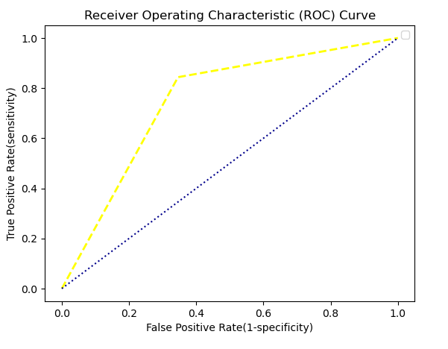
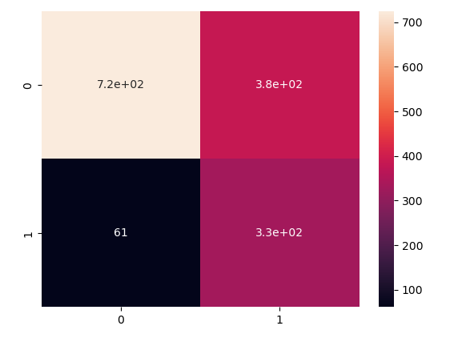
Naïve Bayes
Library used : sklearn.naive_bayes (GaussianNB)
Split used for training and texting the data is [70 : 30]
Feature Scaling was performed after splitting the dataset to avoid information leakage on testing dataset by using standardization method.
Accuracy : 70.36%
Recall : 92.23%
Precision : 65.43%
F1 score : 76.55%

Slide 15
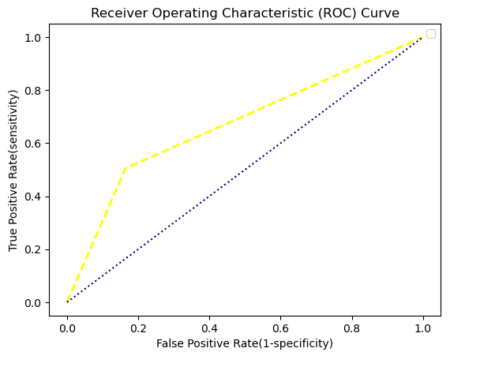
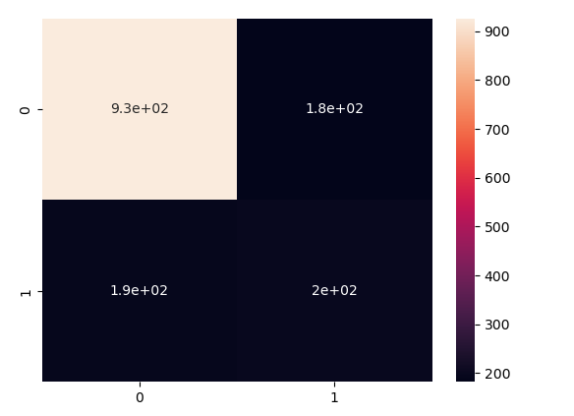
KNN
Library used : sklearn.neighbors (KNeighborsClassifier)
Split used for training and texting the data is [70 : 30]
Feature Scaling was performed after splitting the dataset to avoid information leakage on testing dataset by using standardization method.
Accuracy : 74.96%
Recall : 82.75%
Precision : 83.57%
F1 score : 83.16%

Slide 16
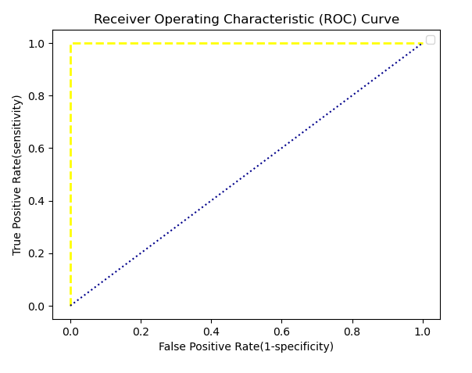
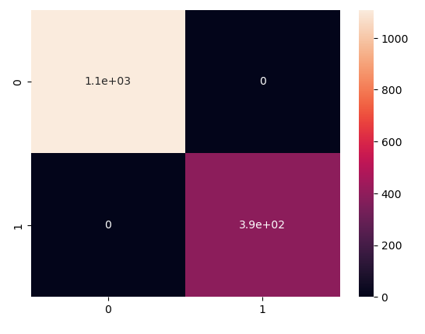
Decision Tree
Library used : sklearn.tree (DecisionTreeClassifier)
Split used for training and texting the data is [70 : 30]
Feature Scaling was performed after splitting the dataset to avoid information leakage on testing dataset by using standardization method.
Accuracy : 100%
Recall : 100%
Precision : 100%
F1 Score : 100%

Slide 17
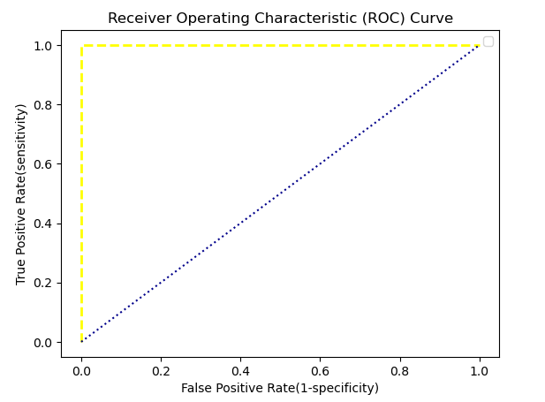
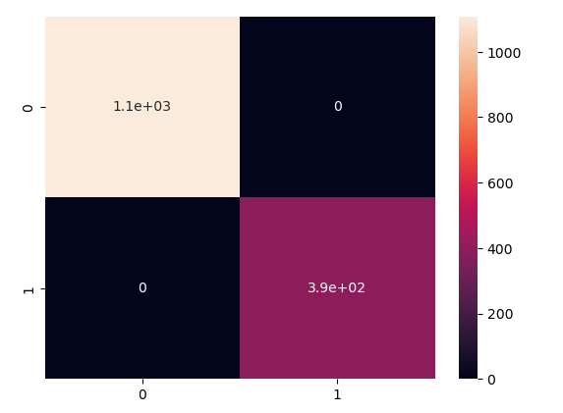
Random Forest
Library used : sklearn.ensemble (RandomForestClaassifier)
Split used for training and texting the data is [70 : 30]
Feature Scaling was performed after splitting the dataset to avoid information leakage on testing dataset by using standardization method.
Accuracy : 100%
Recall : 100%
Precision : 100%
F1 score : 100%

Slide 18
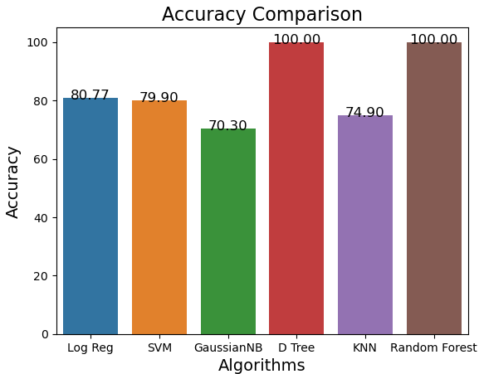
Accuracy Comparison
Decision Tree and Random Forest have the highest accuracy.
Both the models doesn’t miss classifies any customers. We don’t want any person who wants to stay with the company shows he will not continue.

Slide 19
THANK YOU

